Slide 1

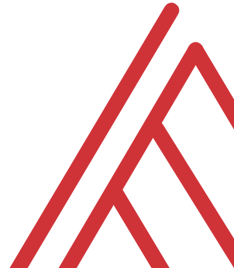
Advancing into Analytics: From Excel to R and Python

Slide 2
Learning objectives
Situate Excel in the data analytics stack
Chart a clear learning path from Excel to R and Python
Demonstrate tangible use cases for combining these tools

Slide 3
Unofficial learning objectives
Having fun with data & computers

Slide 4
What is the data analytics stack?

Slide 5
Spare no tools…
Insert your data analytics stack image here

Slide 6
What is Excel good for?
Good at…
Visual calculations
End-user interactivity
Rapid prototyping
Not so much…
Storing data
Mobilizing data
Implementing advanced analysis

Slide 7
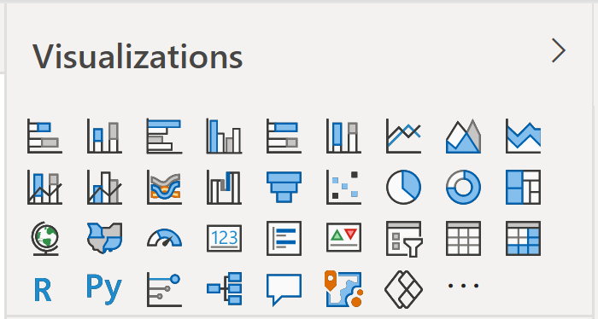
Don’t take my word for it…
Insert Power BI visuals here

Slide 8
The dialects of data
Adding, removing, calculating columns
Sorting and filtering
Aggregating and joining
Pivoting and reshaping

Slide 9
Welcome to the R Project

Slide 10
Welcome to the R project
It’s free
It’s powerful
It’s popular

Slide 11

Packages: “There’s an App for that!”
Install the package
Open the package

Slide 12
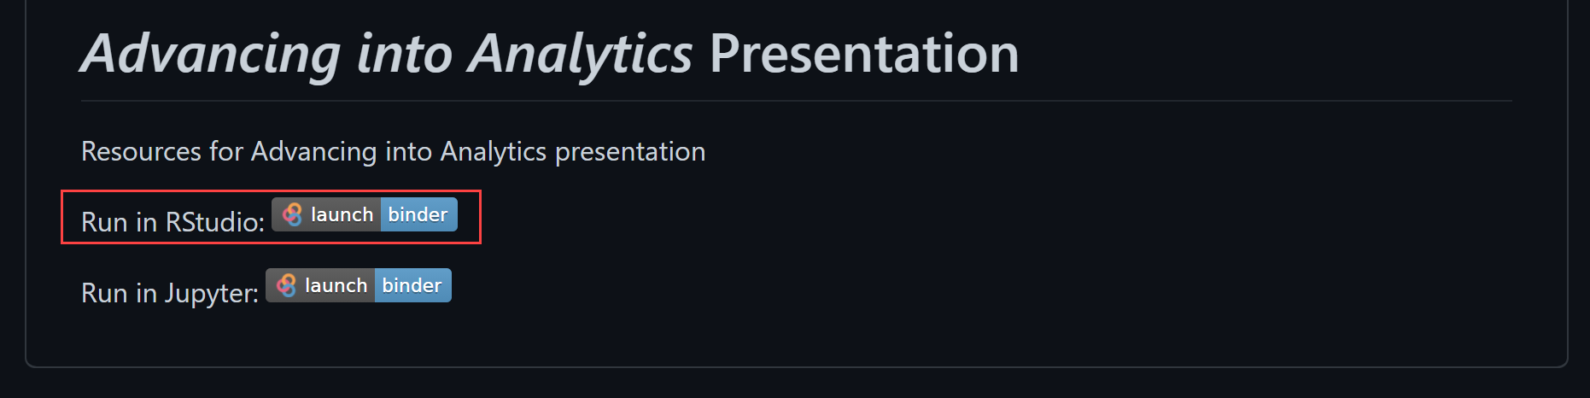

Demo
Navigate RStudio, beginning with 1+1

Slide 13
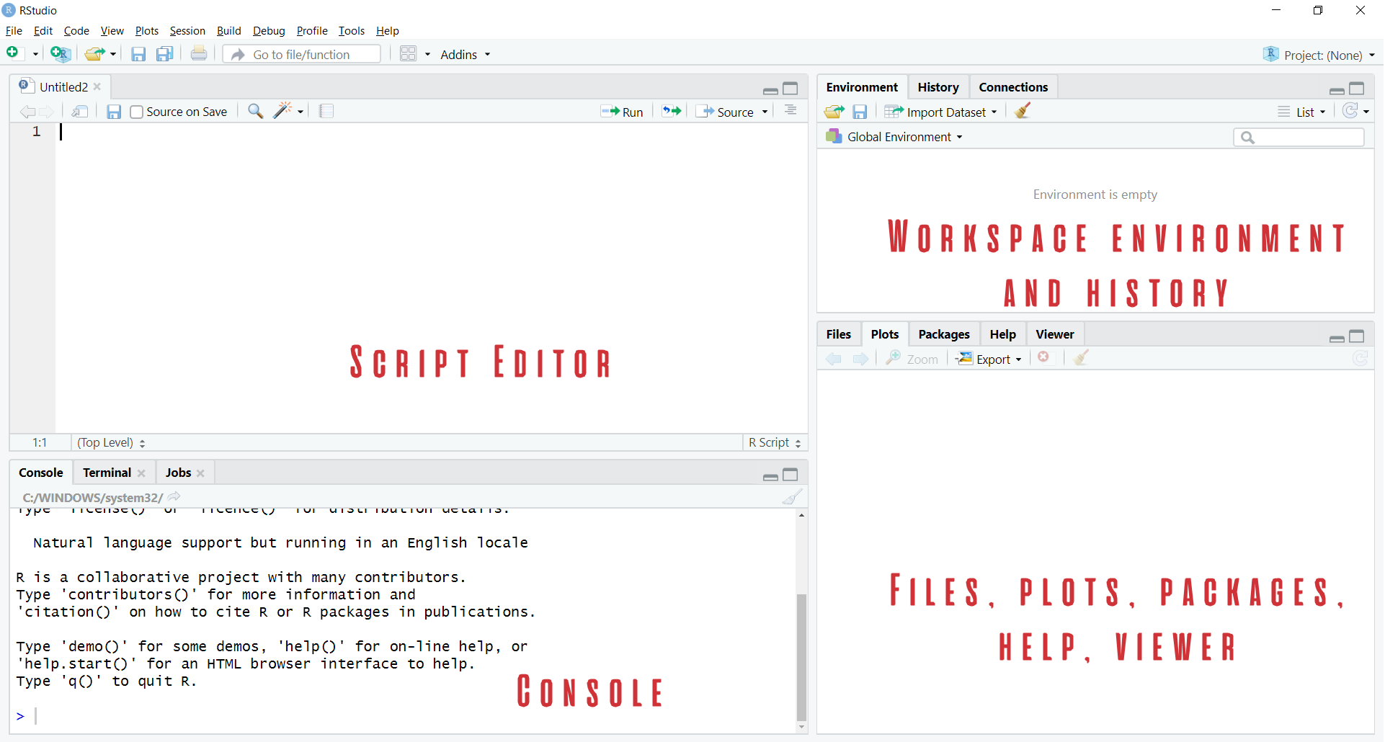
Rstudio Orientation

Slide 14
Prancing into Python

Slide 15
The data world is your oyster shell

Slide 16
Demo
Build a
Decoupling of platforms and applications

Slide 17
Questions?

Slide 18
The two basic things to do in R
Run a function
Create or modify an object

Slide 19
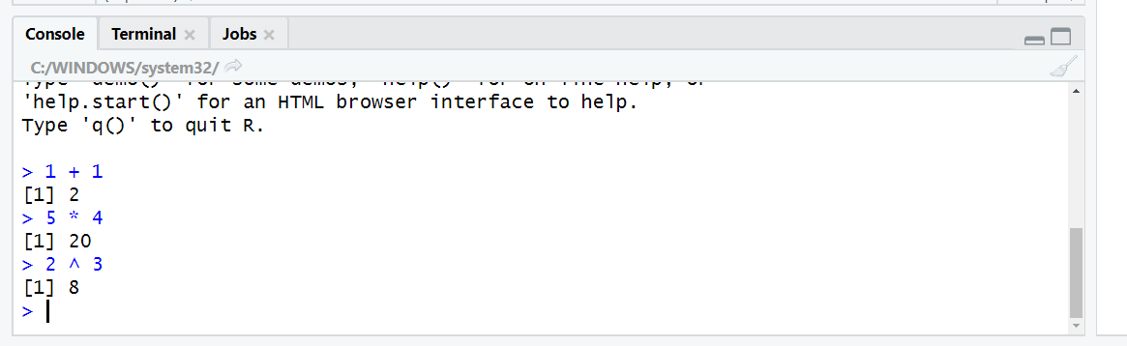
Let’s get working in the console
Use R as a fancy calculator:
Hit Enter to execute

Slide 20
R follows the order of operation and uses scientific notation:
2+3*4/(5+3)*15/2^2+3*4^2
## [1] 55.625
5e4
## [1] 50000

Slide 21
Testing conditions
Condition | Symbol
Equal to | == (not = )
Not equal to | !=
Greater than/less than | >, <
Greater than or equal to/less than or equal to | >=, <=
# Does 5 equal 4?
5 == 4
## [1] FALSE
# Is 10 less than or equal to 11?
10 <= 11
## [1] TRUE
#is the sqrt of 36 equal to 6 squared?
sqrt(36) != 6
## [1] FALSE

Slide 22


Using functions
sqrt(36)
## [1] 6
abs(-5*2)
## [1] 10

Slide 23
R is case-sensitive:
Sqrt(10)
## Error in Sqrt(10): could not find function "Sqrt"

Slide 24
Using functions
sqrt(36)
## [1] 6
abs(-5*2)
## [1] 10

Slide 25
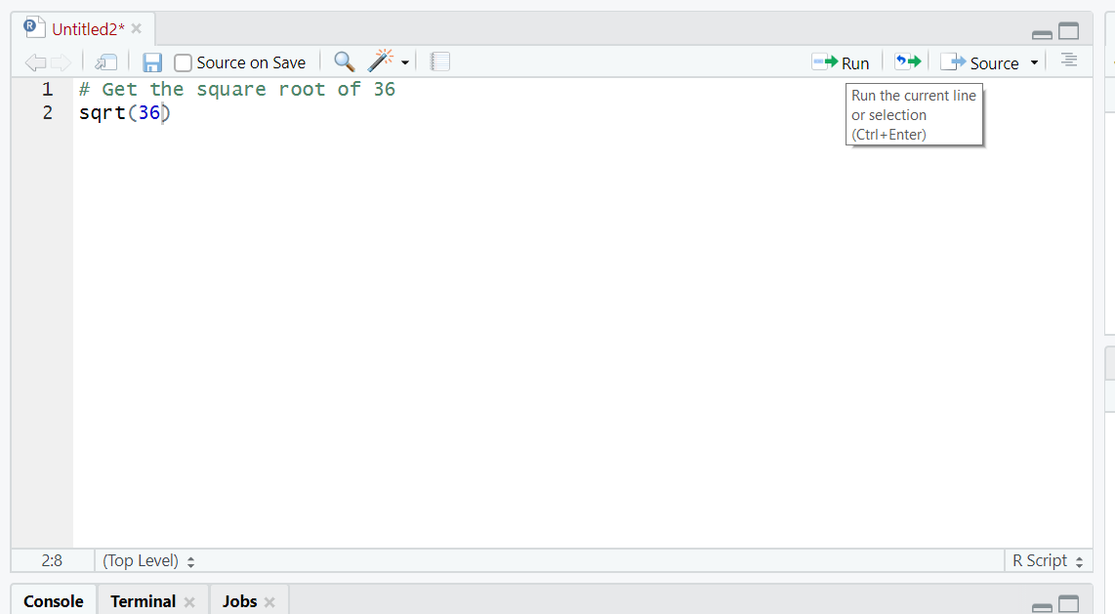
Script: save your code for later

Slide 26
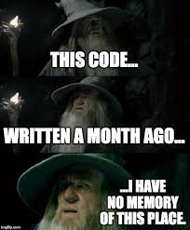
Note to self: use comments (#)

Slide 27
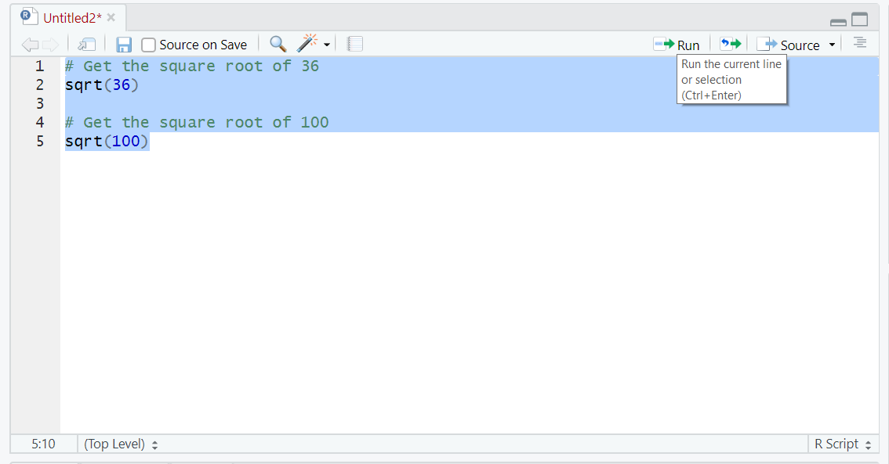
Execute multiple lines

Slide 28
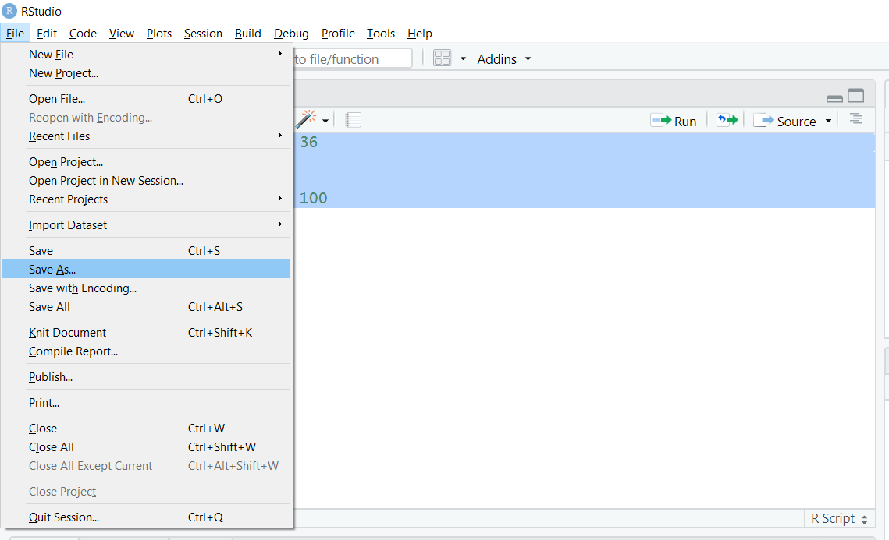
Save your work

Slide 29
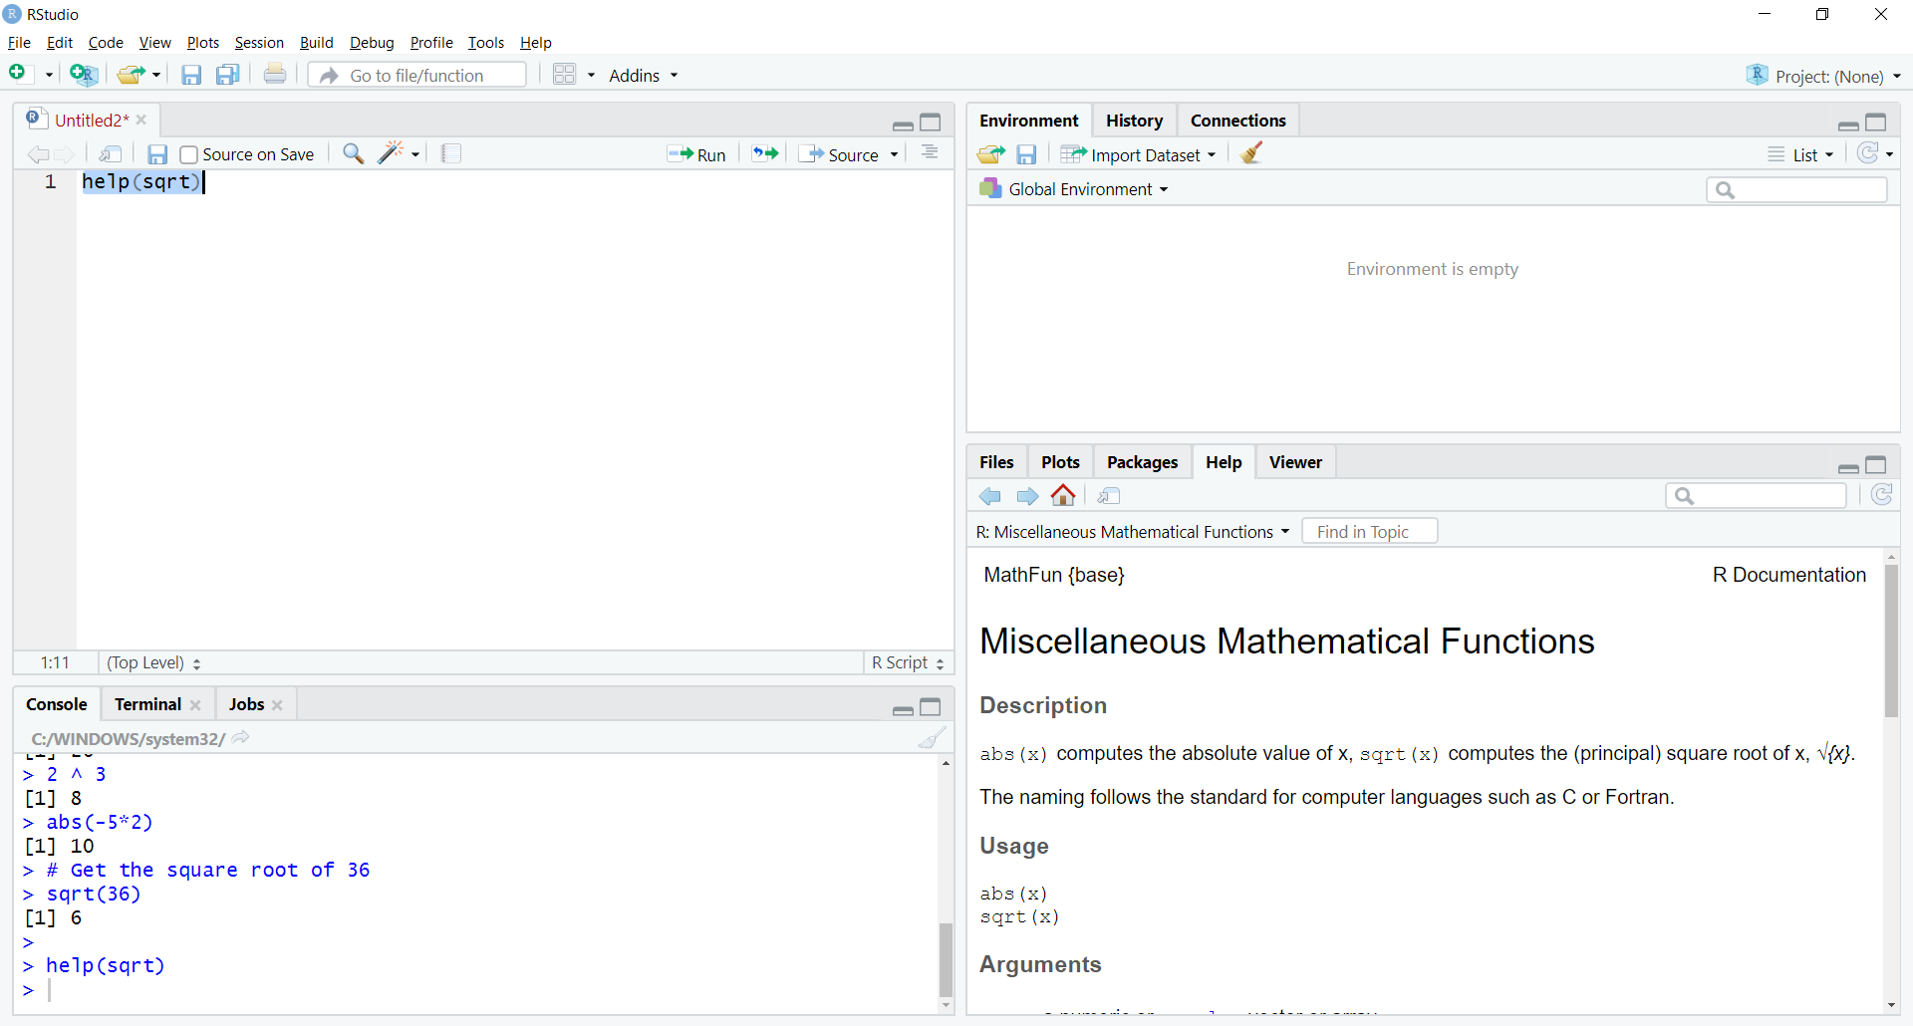
Getting Help (Lower right)

Slide 30
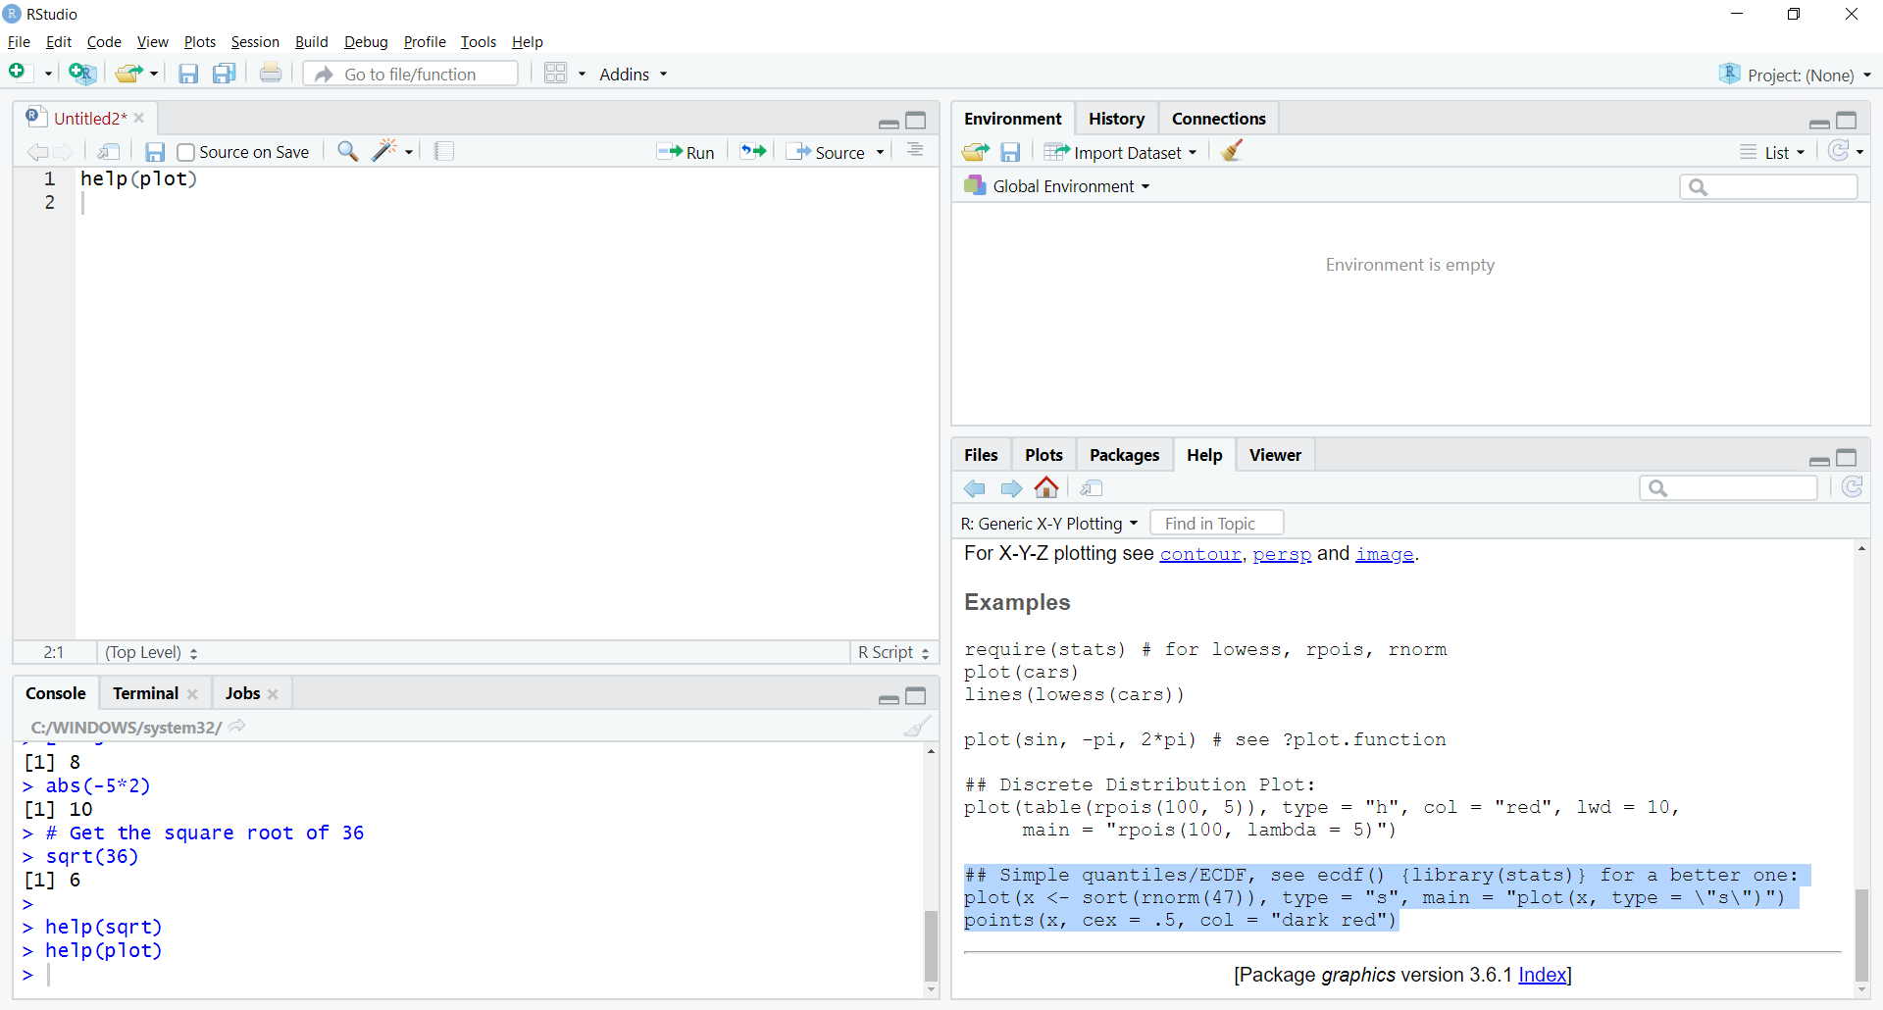
Plotting an example

Slide 31
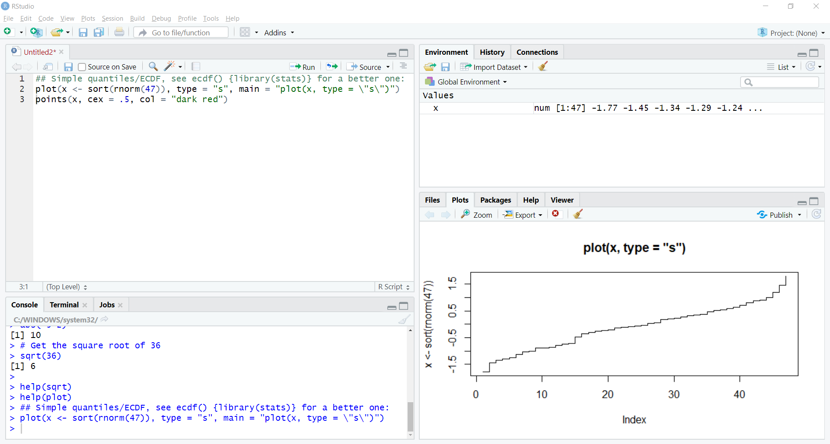
Plotting an example

Slide 32
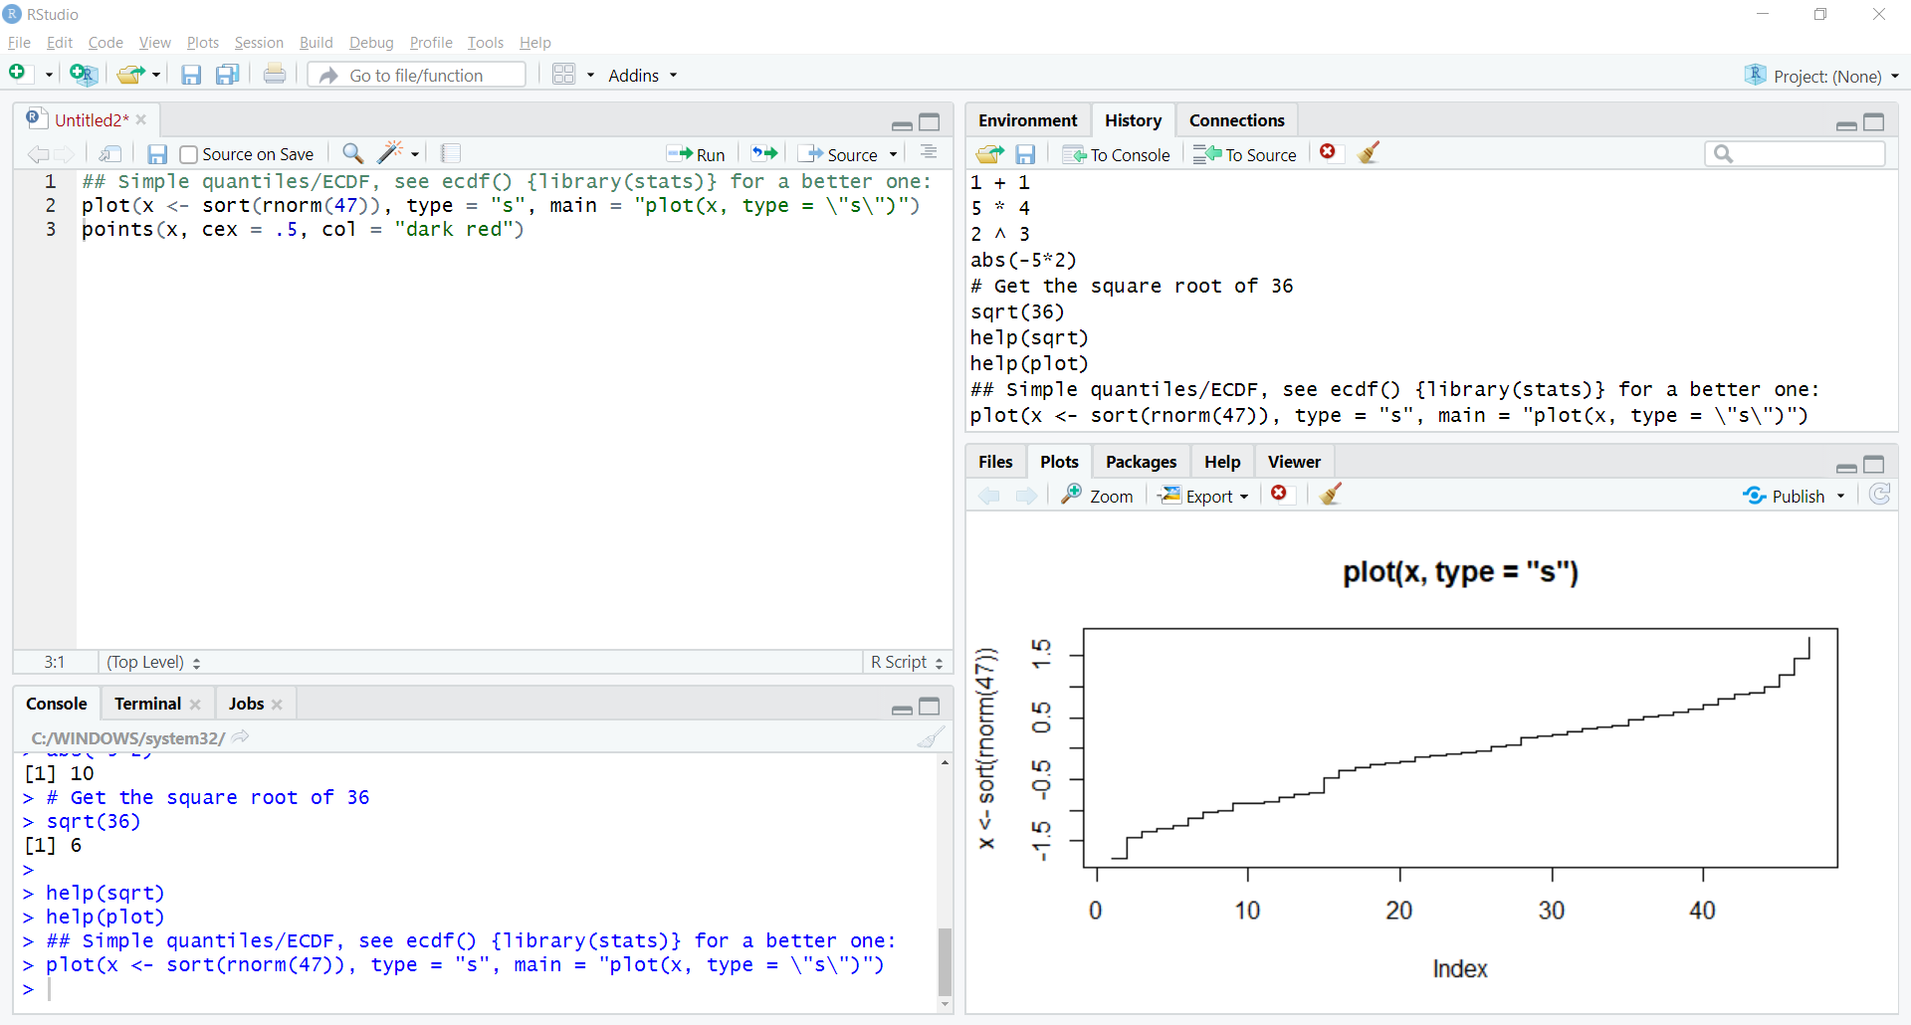
Viewing “R” history

Slide 33
Where did x come from? Us!

Slide 34
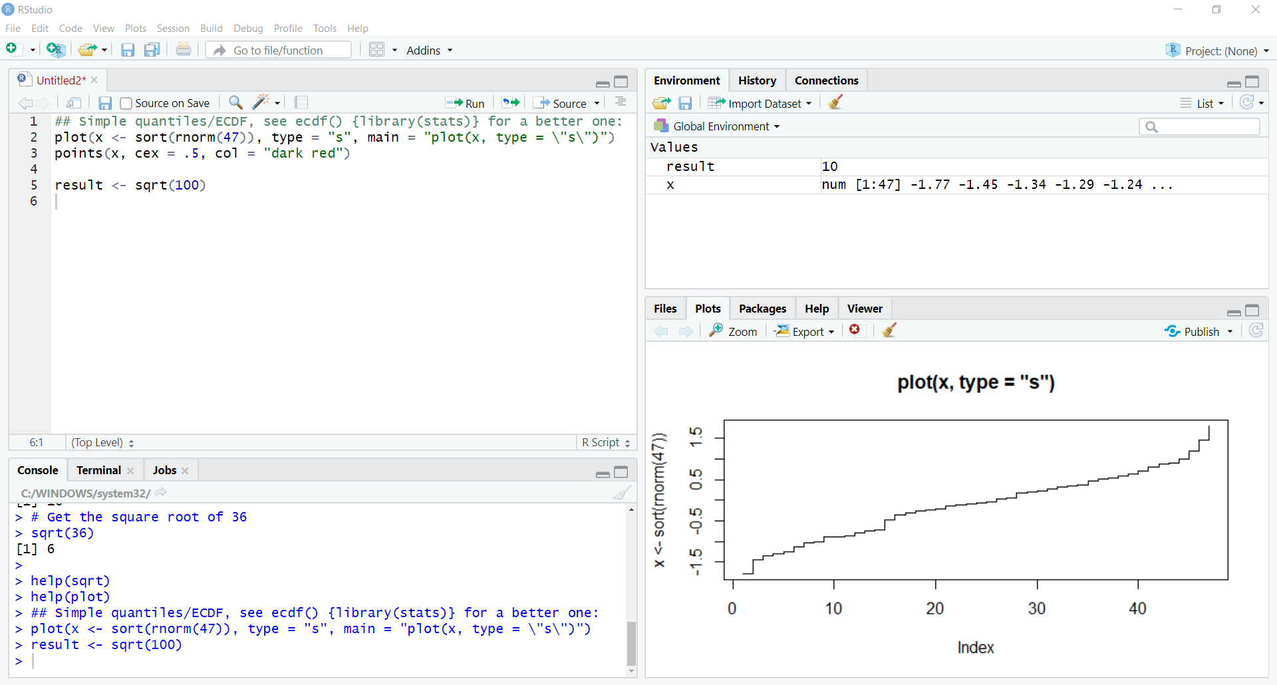
Assigning another object

Slide 35
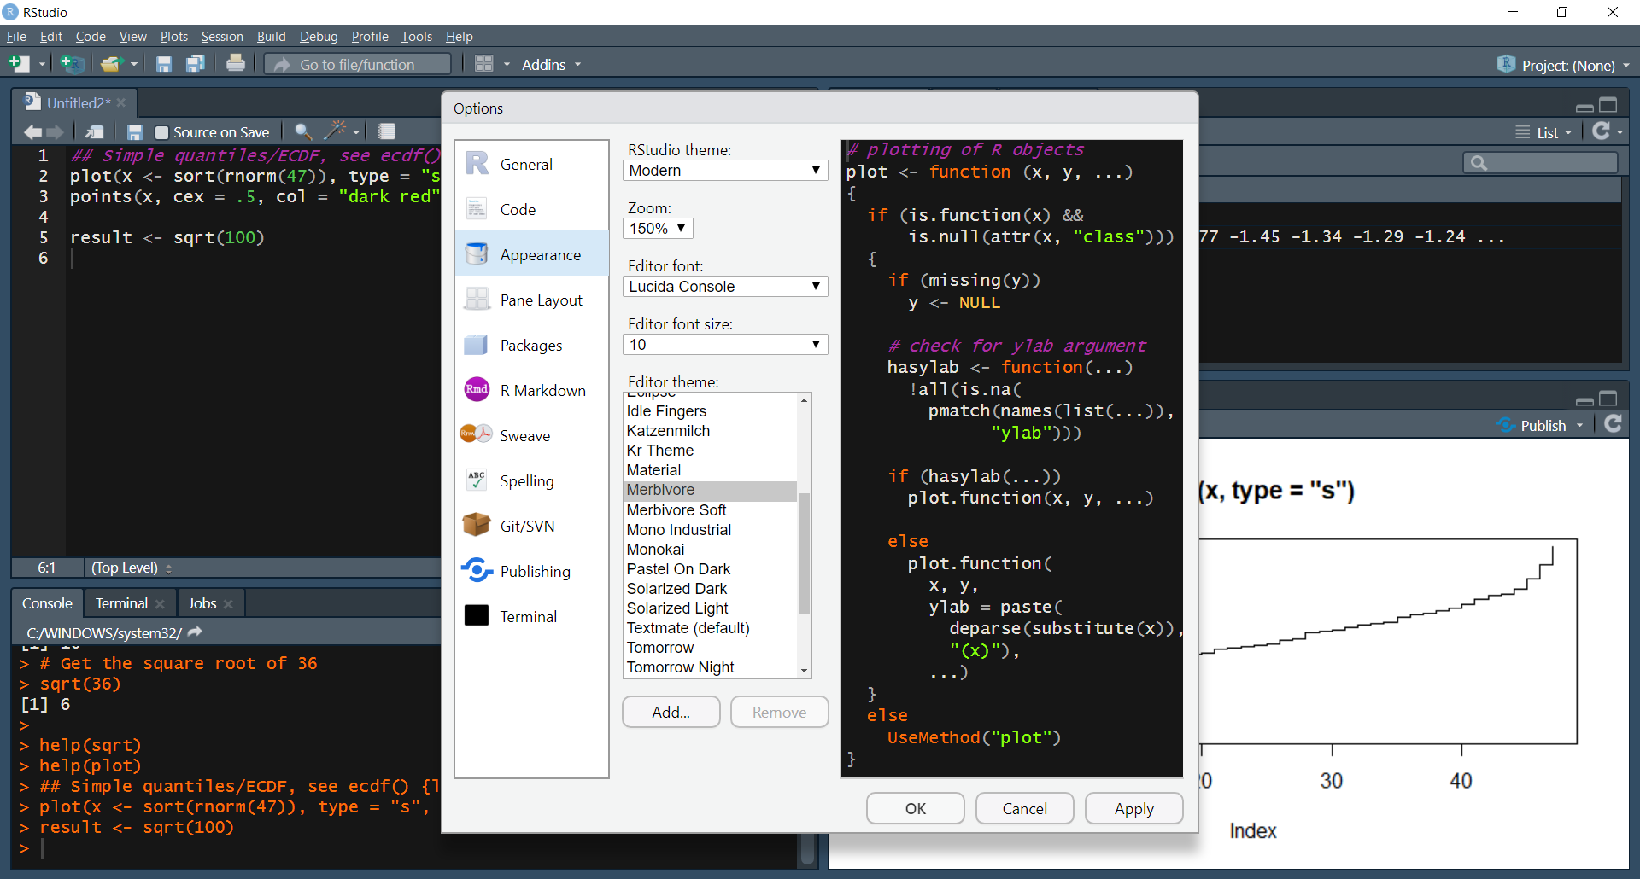
Now for something fun…

Slide 36
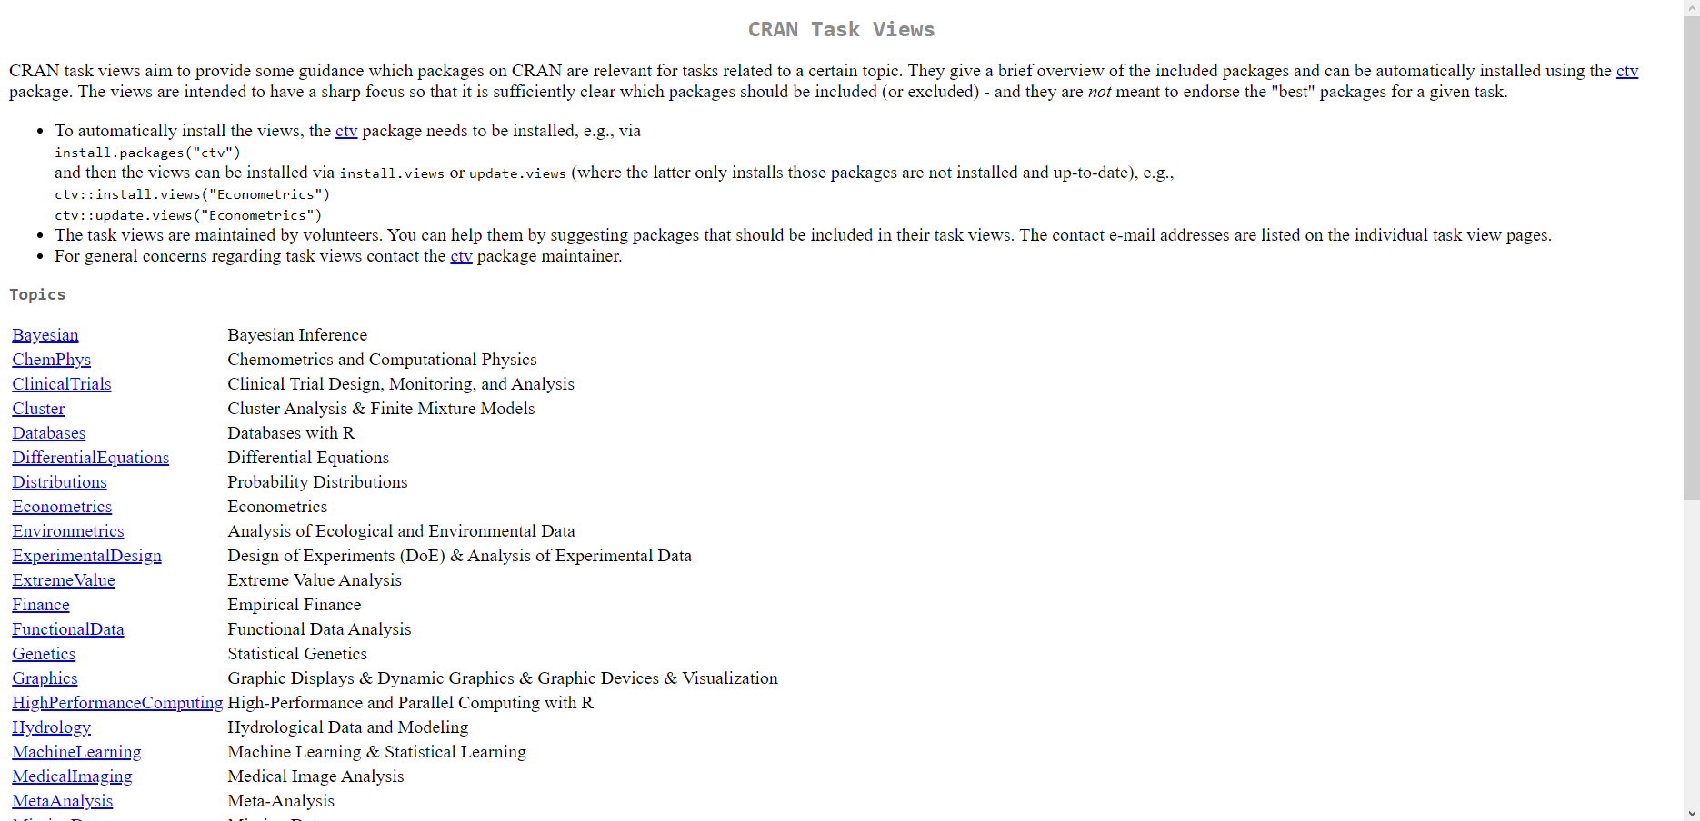
Spinning package playlists: CRAN task Views
https://cran.r-project.org/web/views/

Slide 37
ctv: a package to install other packages:
# Install task views package
install.packages("ctv")
# Load task views package
library(ctv)
# Install Econometrics task view
install.views("Econometrics")

Slide 38
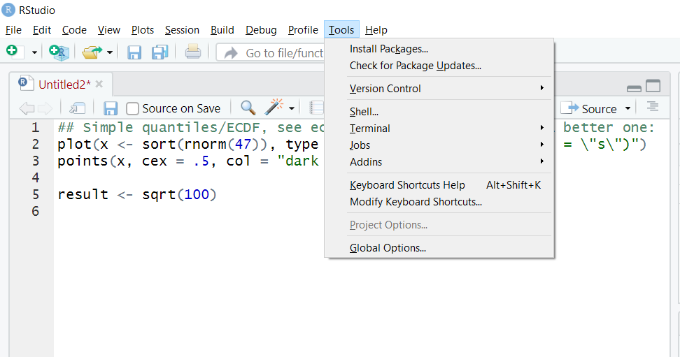
Checking for package updates

Slide 39
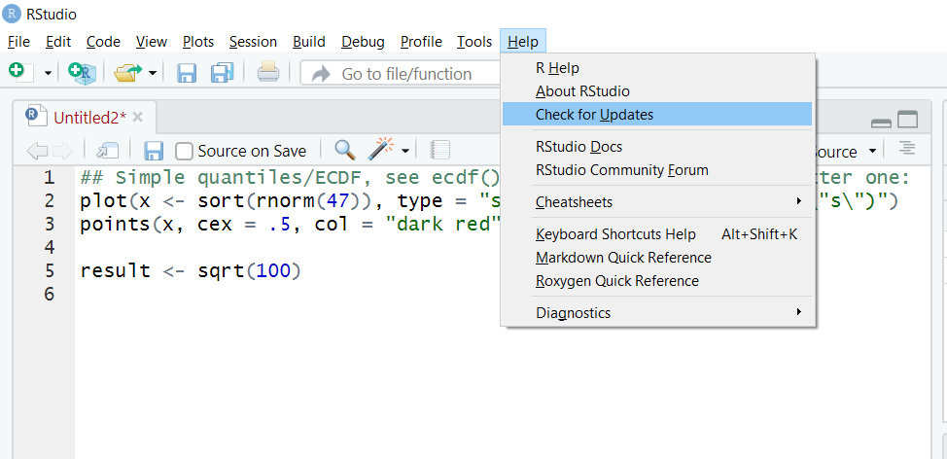
Checking for Rstudio updates

Slide 40
DRILLS
Load the tidyverse package
Call the help documentation on the subset() function
Install the ExtremeValue task view

Slide 41
Questions?

Slide 42

Creating objects
R stores data and output in objects

Slide 43
Creating objects
One option: equals sign (=)
#assign the value of the square root of 100 to
#the object, variable 'result'
result = sqrt(100)

Slide 44
Creating objects
Another (preferred) option: <- (Alt + M)
#assign the value of the square root of 100 to
#the object, variable 'result'
result <- sqrt(100)

Slide 45
Printing objects
#assign the value of the square root of 100 to
#the object, variable 'result'
result <- sqrt(100)

Slide 46
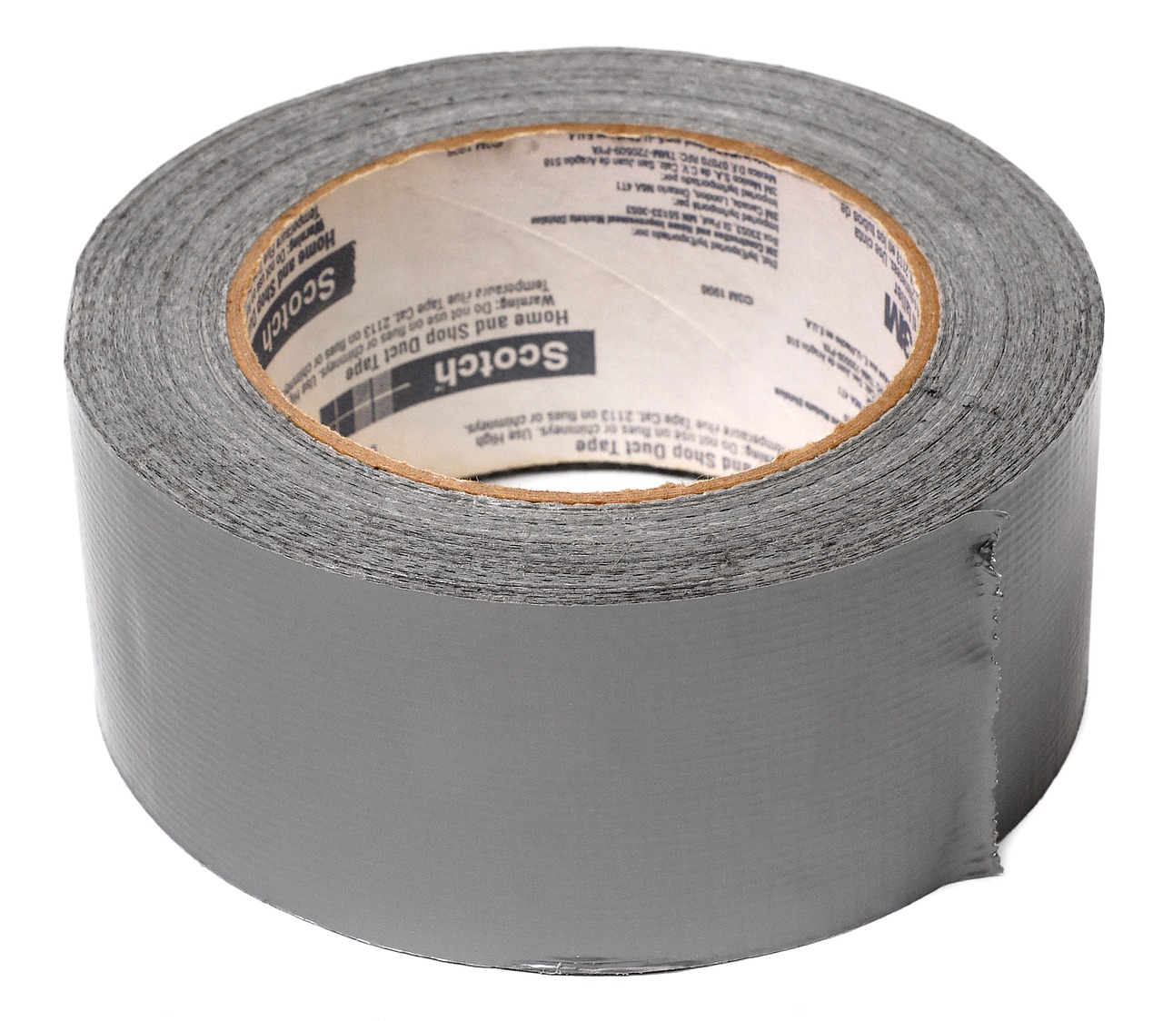

FROM VLOOKUP() DUCT TAPE TO JOIN() BLOWTORCH

Slide 47
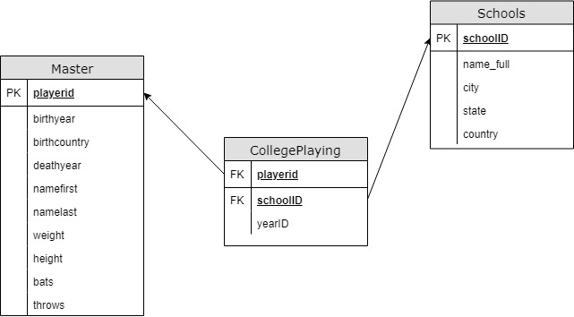
Introducing schemas

Slide 49
Resources

Slide 50
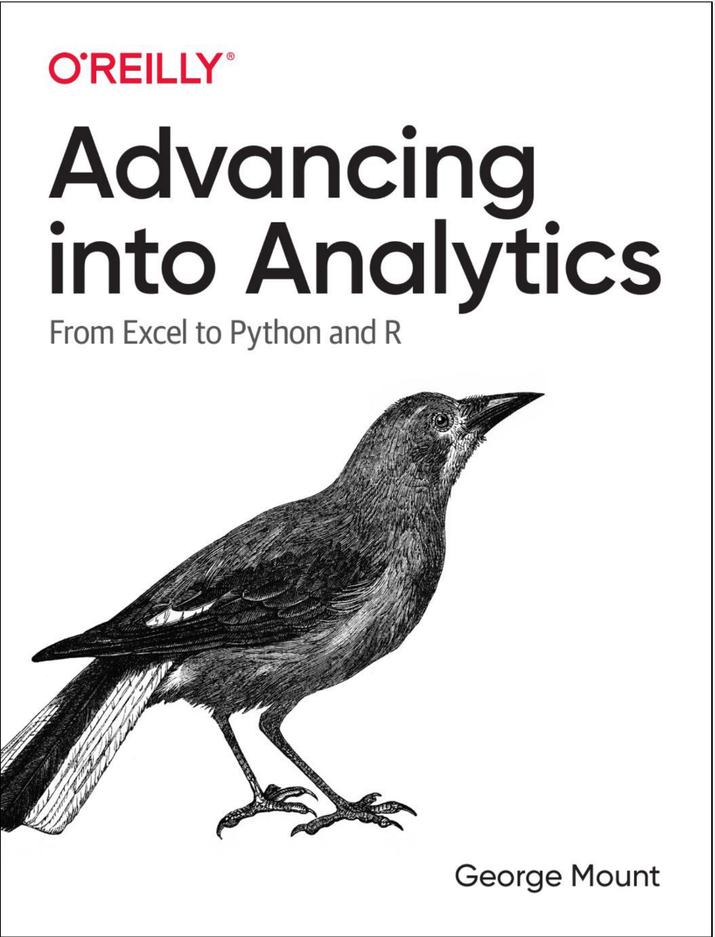
Buy my book
http://georgejmount.com/book/
Learning objective: By the end of this book, you should be able to conduct exploratory data analysis and
hypothesis testing using a programming language.

Slide 51
After you’ve bought my book
R for Data Science by Hadley Wickham and Garrett Grolemund
Python for Data Analysis, 2nd Edition by Wes McKinney
Python for Excel by Felix Zumstein

Slide 52
Get in touch
george@stringfestanalytics.com
stringfestanalytics.com/book
linkedin.com/in/gjmount

